Slide 1
Business, Marketing, Entrepreneurship, Digital Marketing, and Econ Mrs. Schafer

Slide 2
Pricing Exercise Recap
Pricing Vocabulary
Market Share vs. Market Position
Business Calculations
Bartering Assignment

Slide 3
Pricing Exercise Recap
How did the pricing activity go for you?
How did you pick your equilibrium price?
If you could choose your price differently now, what would you do?
Would you actually not change your price, but rather change your product to better fit the target market?
Did we prove the microeconomics principle of demand?
If we disproved it, why? What factors made the outcome different?

Slide 4
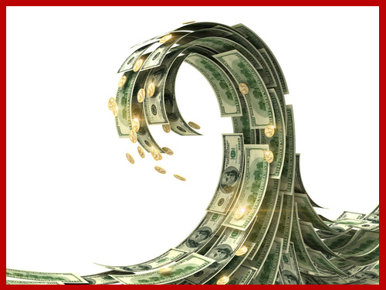
Pricing
Terms/concepts to note
Price
Bartering
Product value (what is the seller’s objective)
Variety of price names
3 goals of pricing
Notes:
Price is value in money placed on a good or service
Oldest form of pricing is bartering-exchange of good or service for another good or service. No money involved
Seller’s objective: set a price high enough for the company to make a profit but not so high that it exceeds the value potential customers place on the product
Price names: rent, commission, dues, fee, interest, wage, tuition, salary, bonus
3 goals of pricing: earning a profit, gaining market share, meeting the competition
https://www.youtube.com/watch?v=8s3bdVxuFBs
This is the 13 min paperclip TED talk video

Slide 5
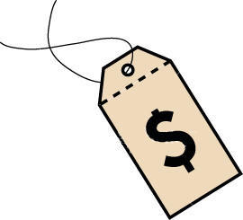
Pricing
Terms/concepts to note
Demand elasticity
Law of diminishing marginal utility
Substitutions
Price fixing
Price discrimination
Unit pricing
Loss leader
Bait and switch advertising
Price gouging
Notes:
Demand elasticity varies with 5 factors: brand loyalty, price relative to income, availability of substitutes, luxury vs necessity, and urgency of purchase
Law of diminishing marginal utility: detergent goes on sale. You buy 5 bottles of it. 3 weeks later a new sale for the same detergent…would you buy more? No, cause you have enough.
No substitutions to popular holiday toy so parents will shift the demand curve
Price fixing: competitors agree on certain price ranges. Can be proven only when there’s evidence of collusion. Sherman antritust act of 1890 outlawed this. Illegal b/c it eliminates competition. Legally required in 19 states.
Price discrimination: when a firm charges dif prices to similar customers in similar situations.
Unit pricing helps consumers compare similar goods that are packaged in dif sizes or come in dif forms.
Unfiar trade practices prohibited b/c it drives out competition. When this isn’t outlawed stores can price an item at low costs to draw customers into a store…this item is called loss leader. Selling tv really low on black Friday
Federal Trade commission steps in to give advertising guidelines
Bait and switch advertising: bus adverts a low price item that they don’t’ actually intend to sell or say they’re out of stock
Price gouging: when price is set higher than normal for a product that’s suddenly in high demand (taxi rides out of NYC on 9/11. Hand sanitizer after Covid)
What role does the gov play in regulating the pricing process?

Slide 6

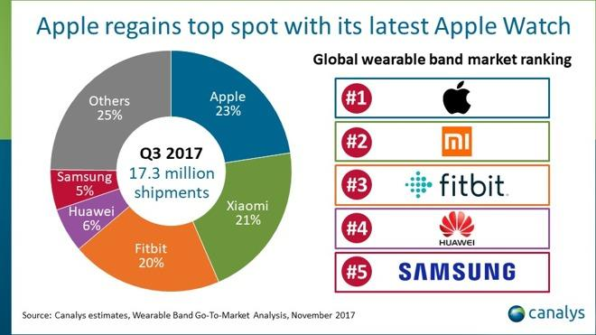
Market Share vs. Market Position
Market share: firm’s percentage of total sales volume generated by all competitors in a given market
Market position: relative standing a competitor has in given market in comparison to its other competitors
Notes:
Market share is firm’s percentage of total sales volume generated by all competitors in a given market
Market position is relative standing a competitor has in given market in comparison to its other competitors

Slide 7
Revenue = PRODUCT PRICE X QUANTITY SOLD
Calculation
Sold 5 t-shirts for $20 each. Revenue = ?

Slide 8
profit = revenue - costs and expenses
Calculation
Sold 5 t-shirts for $20 each. Revenue = $100
Costs of those 5 t-shirts was $30
Profit =?

Slide 9
Return on Investment = profit / Investment
Calculation
Sold 5 t-shirts for $20 each. Revenue = $100
Costs of those 5 t-shirts was $30
Profit = $70
ROI = ?
Notes:
ROI-calculation that is used to determine the relative profitability of a product; formula is rate of return = profit divided by investment
233% ROI on tshirt 100-30=70
70/30=2.33
2.33x100=233% return
ROI-calculation that is used to determine the relative profitability of a product; formula is rate of return = profit divided by investment

Slide 10
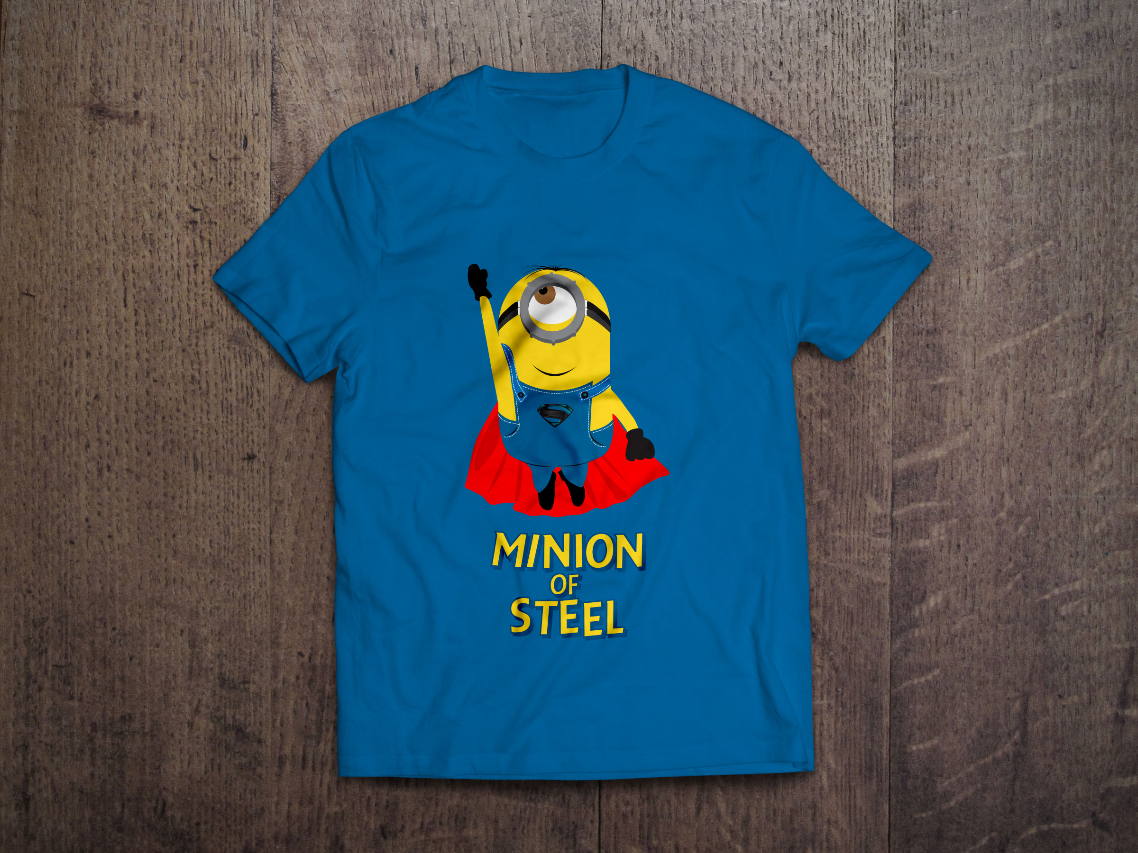
Another ROI Calculation
Calculate Profit on each item.
Then calculate ROI:
Your company sells t-shirts to customers for $10 each. Your cost to make and market the t-shirts is $6. Your profit is $4.
What is your ROI? Rate of return?
Your company wants to achieve a return on investment of at least 75%. What price should the company sell the t-shirts for if they can’t lower the cost to make and market the t-shirts?
This Photo by Unknown Author is licensed under CC BY
Notes:
4/6 so rate of return is 66.67%
A: $10.50 75 = x/6
Calculate Profit on each item. Then calculate ROI: Your company sells t-shirts to customers for $10 each. Your cost to make and market the t-shirts is $6. Your profit is $4.
Rate of return = 4/6 so rate of return is 66.67% Your company wants to achieve a return on investment of at least 75%. What price should the company sell the t-shirts for if they can’t lower the cost to make and maket the t-shirts? A: $10.50 75 = x/6

Slide 11
Break Even Point: Revenue = the cost and expenses of making and distributing a product
Calculation
Cat food manufacturer plans to make 200,000 cans of food that will be sold at $3 each to retailers. The cost of making the can is $2 per unit or a total of $400,000 for all the cans. How many cans must the manufacturer sell to reach the break even point? (Hint-total amount of costs and expenses divided by selling price)
Notes:
Break even pt: point at which sales revenue equals the cost and expenses of making and distributing a product. After this is reached, businesses begin to make a profit on the product
Cat food manufacturer plans to make 200,000 cans of food that will be sold at $3 each to retailers. The cost of making the can is $2 per unit or a total cost of $400,000 for all the cans. How many cans must the manufacturer sell to reach the break even point? Total amount of costs and expenses divided by selling price 400,000/3=133,334 cans before they start making a profit.

Slide 12
Bartering Assignment
https://www.youtube.com/watch?v=8s3bdVxuFBs
This is the 13 min paperclip TED talk video
You get 1 paperclip
Over the next week you’ll trade your paperclip as many times as you can, trying to get the best thing possible.
Your list of trades is due into Teams a week from the day this is assigned.
Best item (as voted on by the class) wins a pick from the bag of good or bad

